Slide 1
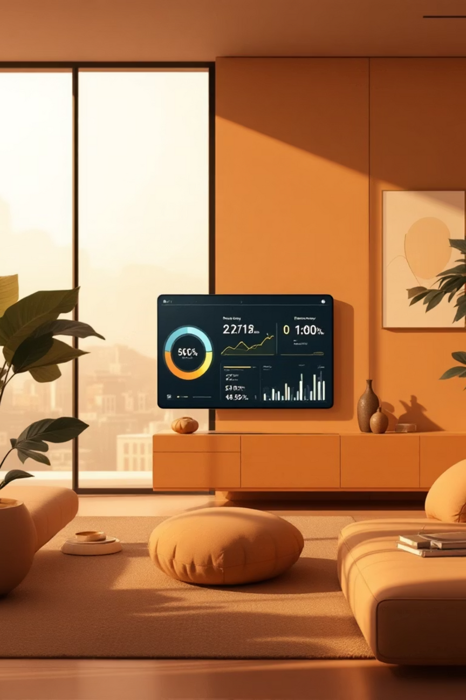
AI-Based Smart Energy Consumption Advisor
Sandhya M(Sri Sairam Engineering College)
SDG 7 – Affordable and Clean Energy | 1M1B – AI for Sustainability Virtual Internship
In collaboration with IBM SkillsBuild & AICTE
Notes:
1

Slide 2


The Challenge: Inefficient Energy Consumption
Inefficient Usage
Many households, hostels, and small institutions consume electricity inefficiently, leading to significant waste.
Lack of Awareness
Users often lack awareness of their energy usage patterns and peak-hour consumption, missing opportunities for savings.
Complex Bills
Current electricity bills are difficult to interpret and provide no actionable insights for reducing consumption.
Environmental Impact
This inefficiency results in higher costs, increased energy wastage, and a rise in carbon emissions, impacting our planet.
An intelligent system is needed to analyze energy usage and guide users toward efficient and clean energy practices.
Notes:
2

Slide 3






Aligned with Global Sustainability Goals
SDG 11: Sustainable Cities & Communities
Contributing to the development of eco-friendly urban and rural environments through smart energy management.
SDG 7: Affordable and Clean Energy
Our primary focus is on promoting efficient energy consumption and encouraging clean energy adoption for a sustainable future.
SDG 13: Climate Action
Directly supporting efforts to combat climate change by reducing carbon footprints associated with energy use.
Notes:
3

Slide 4
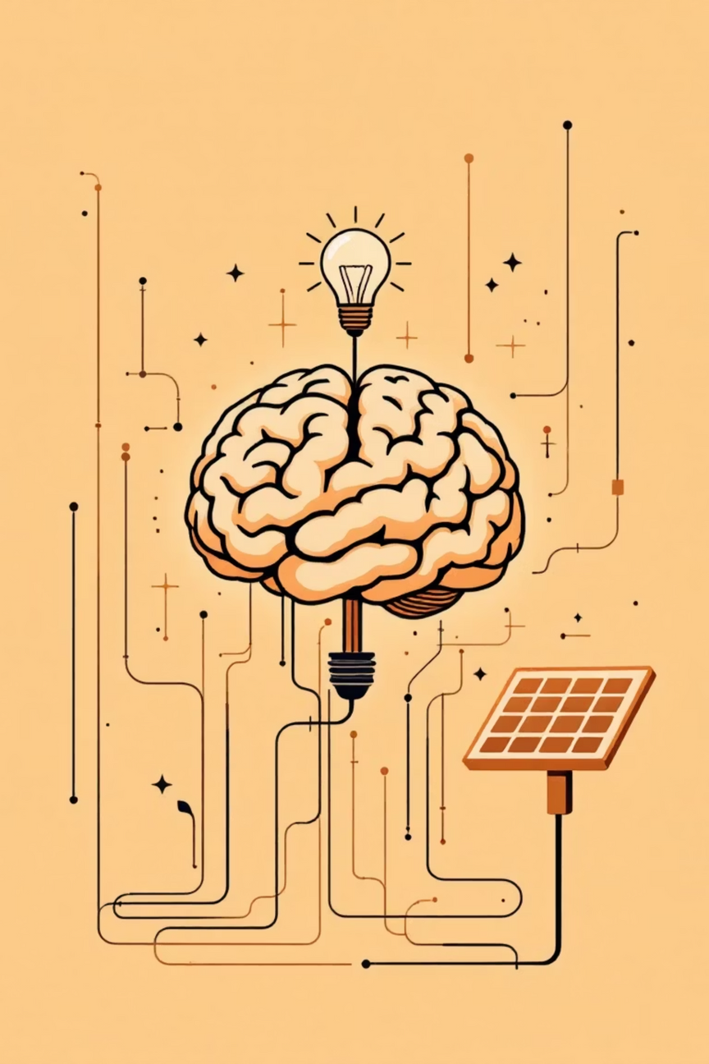
Our AI Solution: Smart Energy Advisor
Comprehensive Analysis
Intelligent Guidance
Analyzes electricity usage data to detect patterns.
Provides personalized recommendations for energy savings.
Identifies consumption trends over time.
Promotes awareness of clean energy solutions.
Classifies energy usage: low, moderate, or high.
Encourages adoption of solar power and other renewables.
This AI-based smart energy consumption advisor empowers users to make informed decisions for a greener tomorrow.
Notes:
4

Slide 5





Seamless Prototype Workflow
Data Input
User provides their electricity usage data.
AI Analysis
AI processes data to identify consumption patterns.
Level Identification
Energy usage is categorized (low, moderate, high).
Recommendation Generation
AI crafts tailored recommendations.
User Insights
User receives insights for cost reduction and clean energy adoption.
Notes:
5

Slide 6







Underlying Technologies & Responsible AI
Technologies Used
Responsible AI Considerations
Python
Core programming language.
Fairness
Ensuring generic and inclusive recommendations for all users.
Pandas
Data manipulation and analysis.
Transparency
Matplotlib
Providing clear and understandable decision logic behind recommendations.
Data visualization for trend graphs.
Rule-Based AI
Privacy
Decision logic for recommendations.
Strictly no personal data collected, focusing solely on energy usage.
Ethics
Prioritizing sustainability and social benefit above all else.
Notes:
6

Slide 7





Impact & Conclusion: A Brighter, Cleaner Future
Reduced Bills
Significant savings on electricity costs.
Improved Awareness
Greater understanding of energy consumption.
Lower Wastage
Minimized energy waste through smart habits.
Clean Energy Push
Encouragement of renewable energy sources.
Environmental Benefit
Direct contribution to global sustainability goals.
This AI-based advisor supports affordable and clean energy practices by helping users make smarter energy decisions, directly aligned with SDG 7.
Notes:
7

